Slide 1

Apache Chemistry
Dima Ionut Daniel

Slide 2
Contents
What is Apache Chemistry?
Architecture
Components
Core
Model
Query
Implementations
CMIS versus JCR
Bibliography

Slide 3

What is Apache Chemistry?
Apache Chemistry is a project of the Apache Software Foundation (ASF).
It provides open source Content Management Interoperability Services (CMIS) for Python, Java, PHP and .NET.
Apache Chemistry is becoming a top-level project(TLP) of the Apache Software Foundation (ASF).
OpenCMIS is a subproject of the Apache Chemistry project.
The goal of OpenCMIS is to make CMIS simple for client and server Java developers.

Slide 4
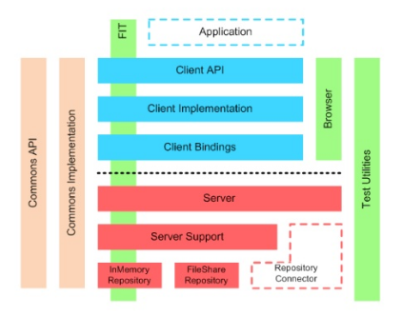
Architecture

Slide 5
Components
The OpenCMIS products are:
A server-side Java library
A client-side Java library
A client-side Android library
CMIS Workbench: a CMIS heavy client, that allows all CMIS operations, and allows to run the TCK unit tests
OpenCMIS Server Webapps: a CMIS server and web user interface
OpenCMIS JCR Repository: A wrapper to use JCR repositories via CMIS
OpenCMIS Bridge

Slide 6
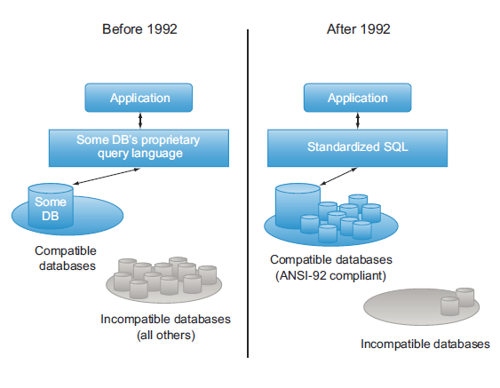
Core
Each Enterprise Content Management(ECM) system had its own API.
CMIS(Content Management Interoperability Services ) is a vendor-neutral, language-independent specification for working with ECM systems.
ECM systems are called sometimes rich content repositories or more loosely, unstructured repositories.

Slide 7
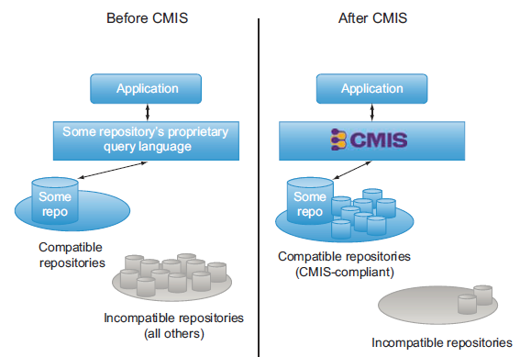
Core (cont.)
CMIS standardizes the way applications work with rich content repositories in much the same way SQL did for relational databases.

Slide 8
Core (cont.)
CMIS is a standard, and the explanation of the standard is called a specification.
The CMIS specification describes the data model, services, and bindings (how a specific wire protocol is hooked up to the services) that all CMIS-compliant servers must support.
The CMIS specification is maintained using a collaborative, open process managed by the Organization for the Advancement of Structured Information Standards (OASIS).

Slide 9
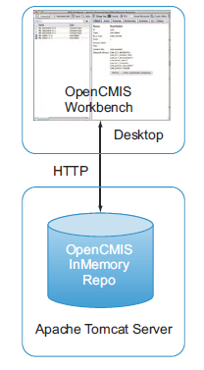
Core (cont.)
The OpenCMIS InMemory Repository, as the name suggests, is a CMIS-compliant repository that runs entirely in memory.
The CMIS Workbench is a Java Swing application that use as a CMIS client to work with objects in the CMIS server.

Slide 10
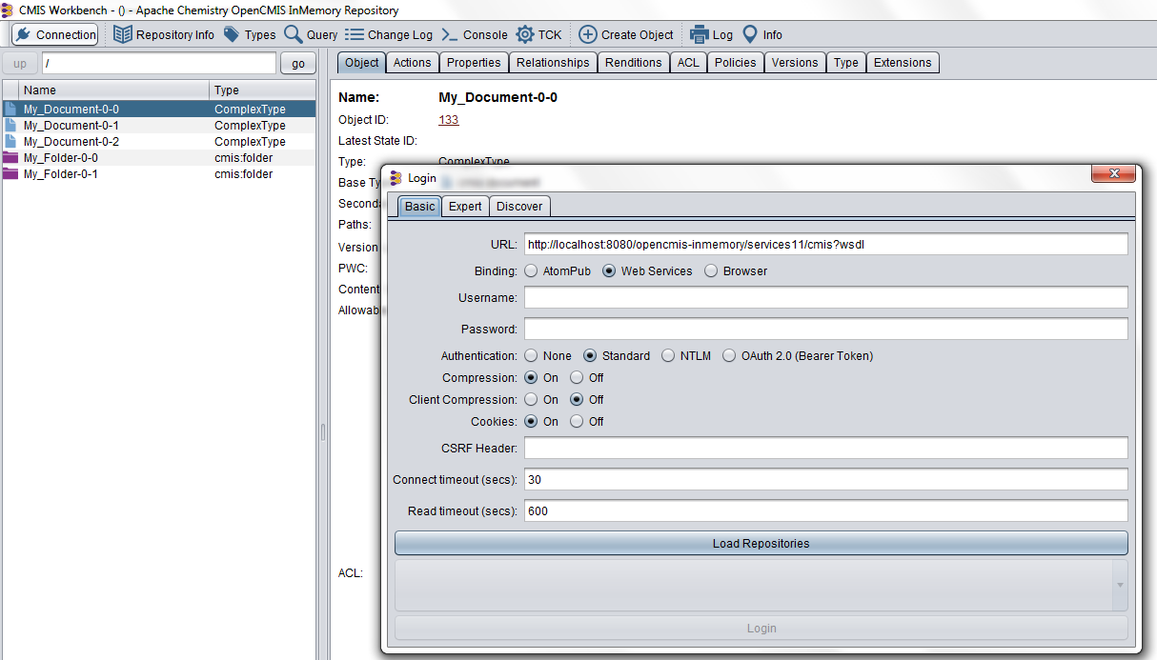
Core (cont.)

Slide 11
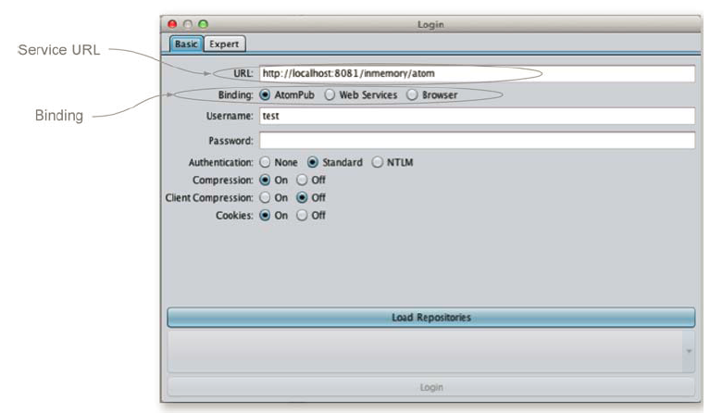
Core (cont.)
To talk to the OpenCMIS InMemory Repository we need to choose a binding and the server’s service URL, which depends on the binding you choose.
The binding is the method(protocol) the CMIS client will use to talk to the server.
In CMIS version 1.0, the two choices for binding are Atom Publishing Protocol (AtomPub) and Web Services.
CMIS version 1.1 adds a third binding called the Browser binding.

Slide 12
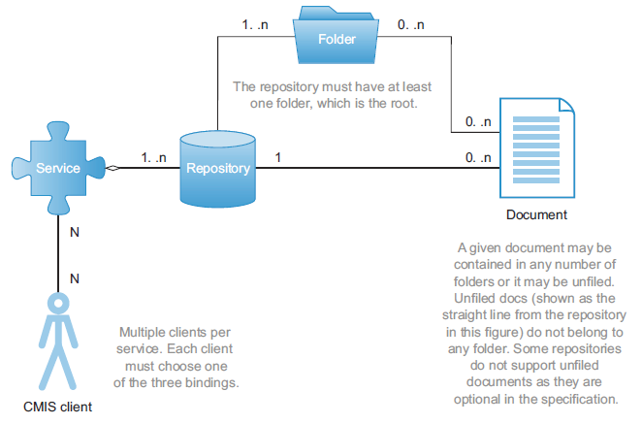
Model
CMIS high-level object types

Slide 13
Model (cont.)
The CMIS service is responsible for these three functions:
Allow a client to discover what repositories are present for this particular CMIS service.
Provide all the details about the capabilities of these repositories.
For each of the repositories, publish the interfaces for the nine subservices that are exposed for every CMIS repository.

Slide 14
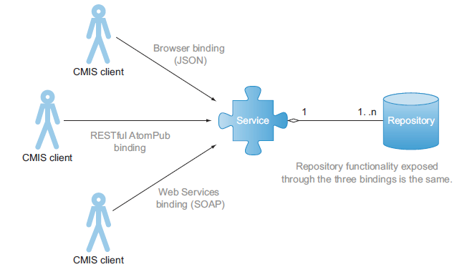
Model (cont.)
CMIS subservices:
Repository services
Navigation services
Object services
Multifiling services
Discovery services
Versioning services
Relationship services
Policy services
ACL (access control lists) services

Slide 15
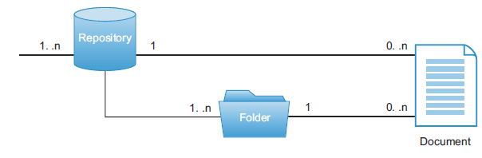
Model (cont.)
Folders in CMIS are much like folders in filesystems.
Every CMIS repository must have at least one folder, the root folder.
Every base CMIS object type has a unique ID defined by the specification.
For folders the ID is cmis:folder.

Slide 16
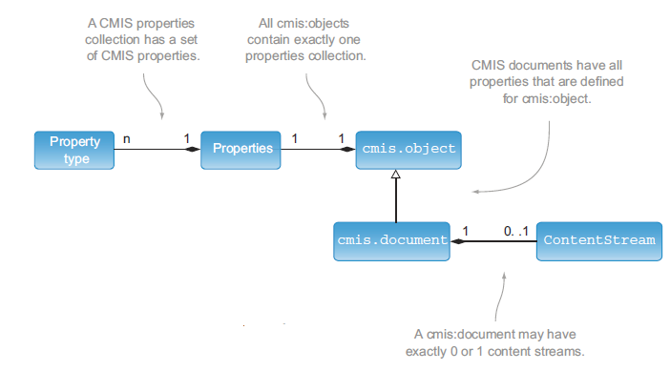
Model (cont.)
CMIS object model view: properties are common to all object types, but only document has a content stream.

Slide 17
Model (cont.)
All CMIS objects have properties. Common properties:
cmis:name (String) →The name of this object.
cmis:objectId (ID) → The opaque identifier for this object. It’s unique among all other objects in this repository.
cmis:baseTypeId (ID) → The opaque identifier for the base type of this object.
cmis:objectTypeId (ID) →The opaque identifier for this object’s type.
cmis:createdBy (String) → The name of the user that created this object in this repository.
cmis:creationDate (DateTime) → The date and time when this object was created.
cmis:lastModifiedBy (String) → The name of the user who last modified this object.
cmis:lastModificationDate (DateTime) → The date and time this object was last modified.
cmis:changeToken (String) → An opaque token used to identify a point in the lifecycle of this object.

Slide 18
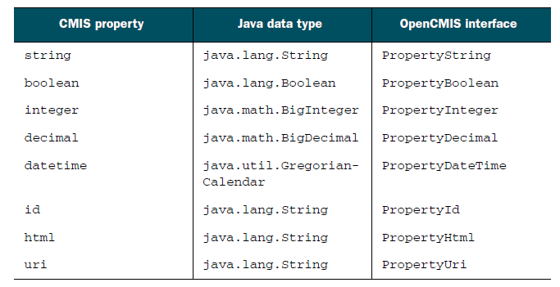
Model (cont.)
All CMIS properties are typed and must be one of the eight base property data types listed in the specification.

Slide 19
Query
CMIS defines a powerful and flexible way to describe searches, using SQL syntax.
CMIS 1.0 and 1.1 Query is based on SQL-92 (ISO/IEC 9075).
CMIS SQL is read-only.

Slide 20
Query (cont.)
SELECT: The properties that will be returned for each object in the result set; we can call them “virtual columns.”
FROM: The queryable object type; you can call it a “virtual table.”
WHERE: An optional clause to specify the conditions on the virtual columns.
ORDER BY: An optional clause to specify how the objects in the result set will be sorted based on the virtual columns.

Slide 21
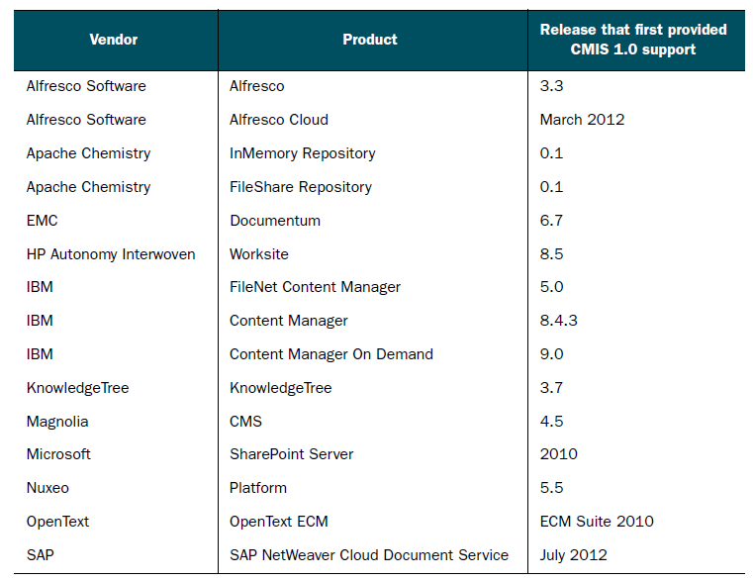
Implementations

Slide 22
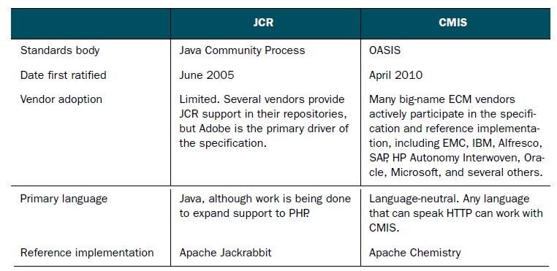
CMIS versus JCR
Java Content Repository (JCR) API is sometimes referred to as Java Specification Request (JSR) 170.
CMIS and JCR aren’t completely mutually exclusive.
A given ECM repository might be compliant with both standards,.

Slide 23

Bibliography
Manning – Apache Chemistry in Action

